Slide 1


Slide 2



USERNAME
PASSWORD
REMEMBER ME (ONLY FOR 1 MONTH)
LOGIN / SIGN IN
SIGN UP / CREATE AN ACCOUNT

Slide 3
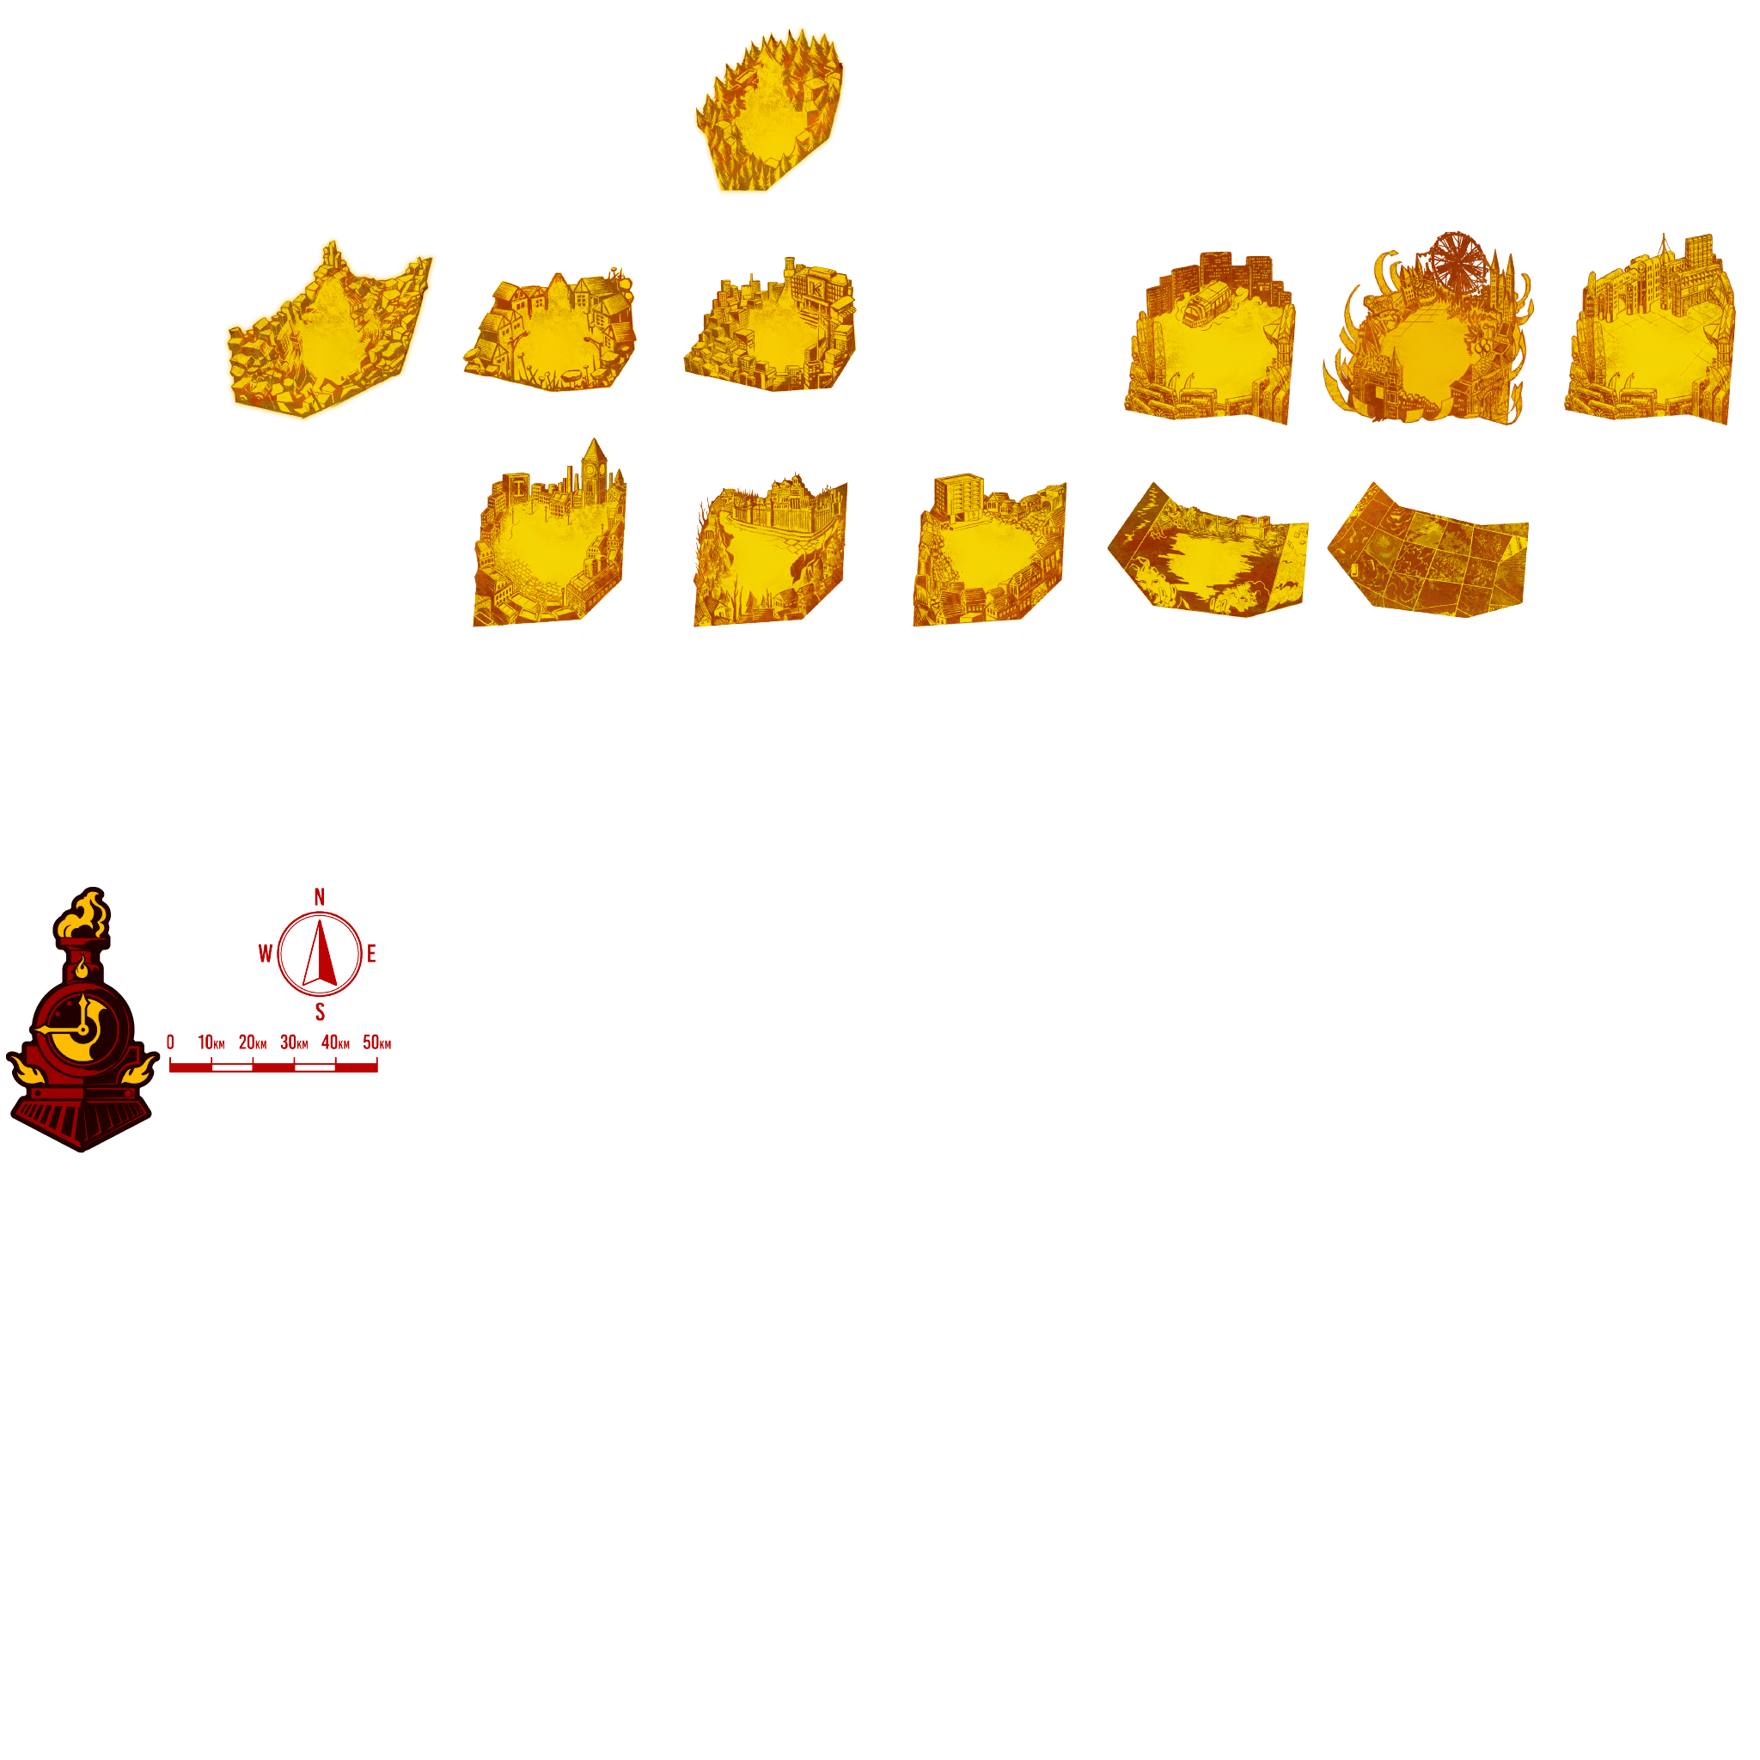


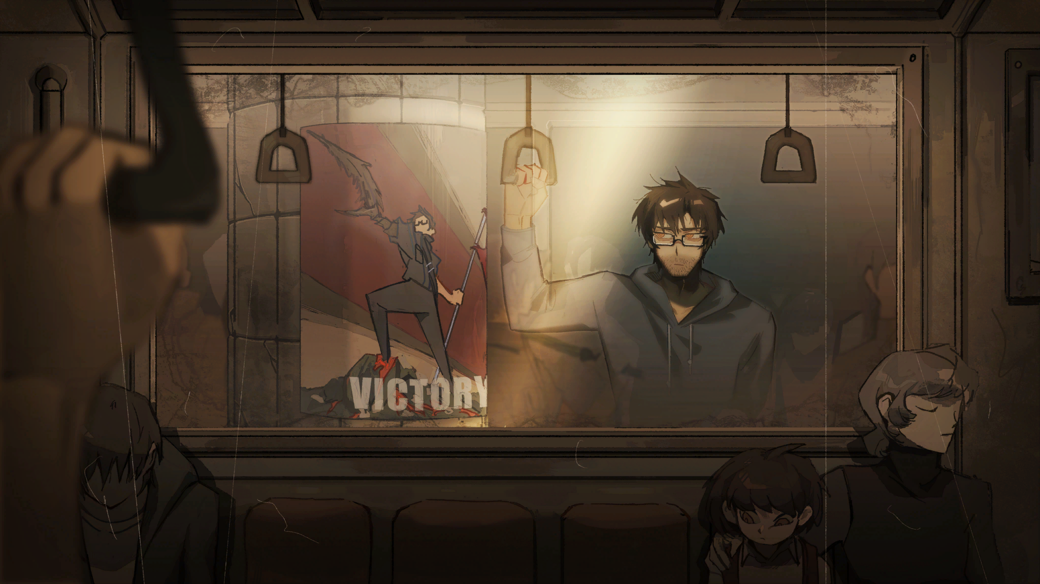

HOME BALIK
EPISODES YUGTO
MORE HIGIT
MEDIA MIDYA
02/27/2023 CANTO I: THE OUTCAST “ I was given the role of Manager. My Guide instructed me to find a branch of gold, to which my head nodded. Unknowingly, I walked face-first into one of nightmares. “
> > LOADING …
WATCH NOW PANOORIN NA
LIMBUS NEWS

Slide 4

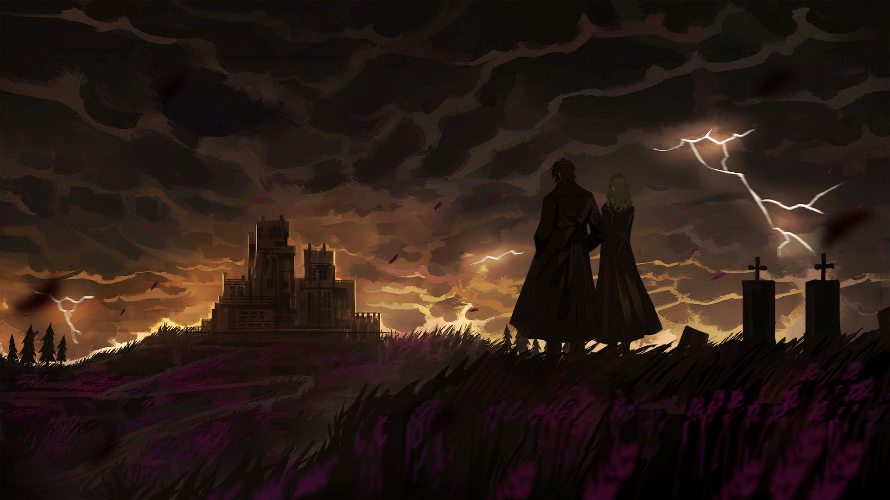


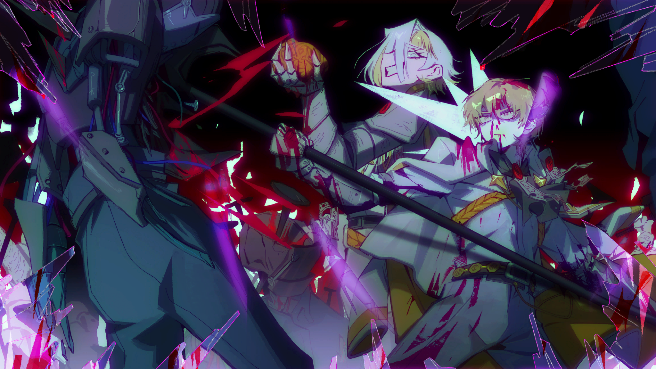
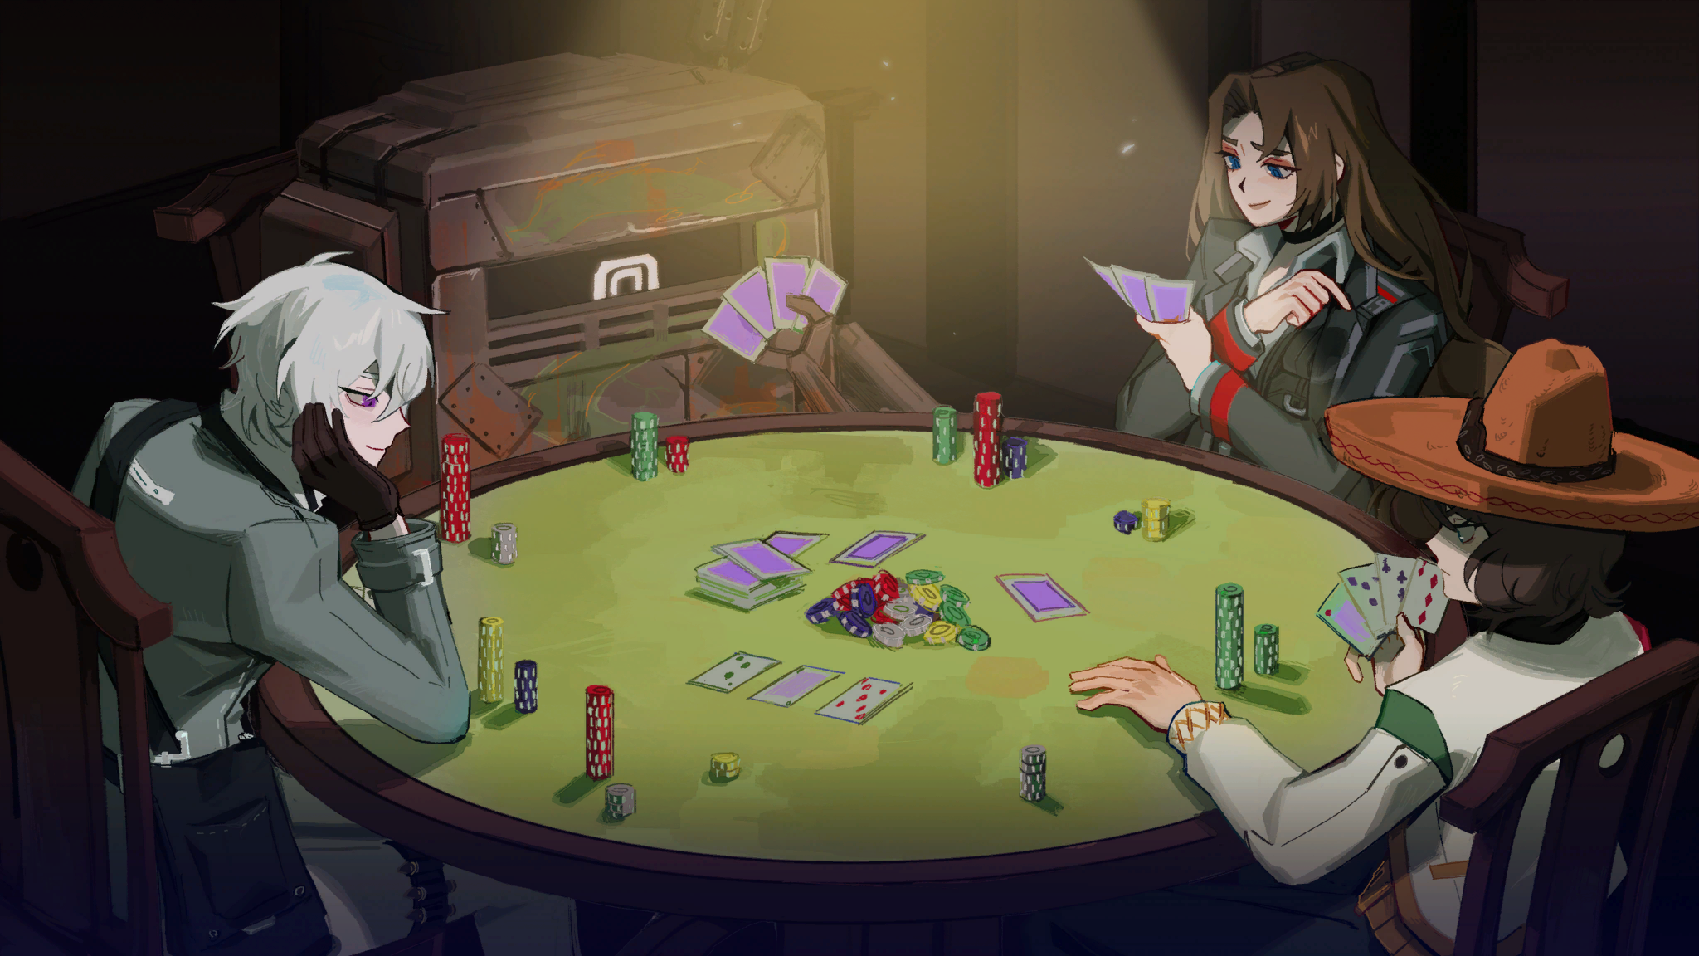






HOME BALIK
EPISODES YUGTO
MORE HIGIT
MEDIA MIDYA
02/27/2023 CANTO I: THE OUTCAST “ I was given the role of Manager. My Guide instructed me to find a branch of gold, to which my head nodded. Unknowingly, I walked face-first into one of nightmares. “
WATCH NOW PANOORIN NA
LIMBUS NEWS

Slide 5

HOME BALIK
EPISODES YUGTO
MORE HIGIT
MEDIA MIDYA
02/27/2023 CANTO II: THE UNLOVING “ Trespassers took the Golden Bough. Sighing, the Guide offered another chance. Determined to succeed this time, we marched into a world of pleasure and ice.. “
WATCH NOW PANOORIN NA
LIMBUS NEWS

Slide 6
HOME BALIK
EPISODES YUGTO
MORE HIGIT
MEDIA MIDYA
02/27/2023 CANTO III: THE UNCONFRONTING “ Curtains close on a blithe yet chilling comedy. Afterward, I could vaguely sense that a tragedy lies in wait. The bus rumbled along. In the window, I saw fall a silent night. “
WATCH NOW PANOORIN NA
LIMBUS NEWS

Slide 7
HOME BALIK
EPISODES YUGTO
MORE HIGIT
MEDIA MIDYA
06/1/2023 CANTO IV: THE UNCHANGING “ We received our first request. The excitement was short-lived as we watched chaos unfold in the middle of K Corp.'s Nest. Time is winded as usual, and a pair of downcast eyes catch my attention. “
WATCH NOW PANOORIN NA
LIMBUS NEWS

Slide 8
HOME BALIK
EPISODES YUGTO
MORE HIGIT
MEDIA MIDYA
11/16/2023 CANTO V: THE EVIL DEFINING “ Amidst the conflict that knew no end, we set sail on the Great Lake. Into its ineffable Waves, into the flames of a certain wrath. “
WATCH NOW PANOORIN NA
LIMBUS NEWS

Slide 9
HOME BALIK
EPISODES YUGTO
MORE HIGIT
MEDIA MIDYA
03/28/2024 CANTO VI: THE HEARTBREAKING “ The colors are fading, and a storm is approaching. Beyond the glass windows, we see the wuthering heights. “
WATCH NOW PANOORIN NA
LIMBUS NEWS

Slide 10
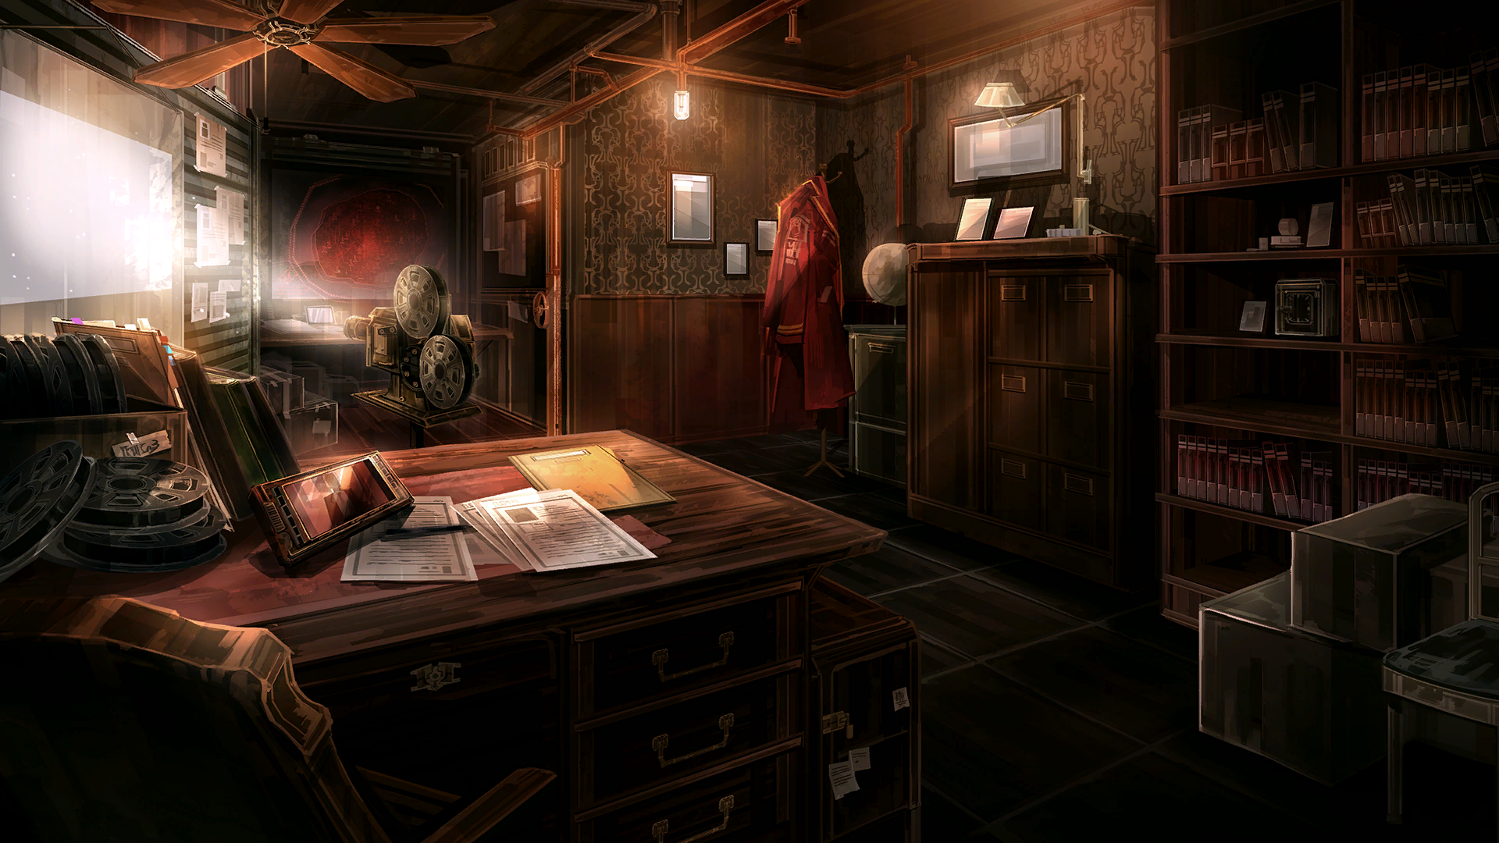
HOME BALIK
EPISODES YUGTO
MORE HIGIT
MEDIA MIDYA
10/10/2024 CANTO VII: THE DREAM ENDING “ With our hearts leaden, we disembark the train. In me is a certain truth hidden, forgotten even by whom it concerns. “
WATCH NOW PANOORIN NA
TO BE CONTINUED
LIMBUS NEWS

Slide 11
HOME BALIK
EPISODES YUGTO
MORE HIGIT
MEDIA MIDYA
T.B.A. CANTO VIII: THE SUNDERRED WITNESSING “ Not released yet. The Surrendered Witnessing is the eighth Story Chapter of Limbus Company, and is Hong Lu's focus chapter. It will be released sometime during 2025 . “
TO BE CONTINUED
LIMBUS NEWS

Slide 12
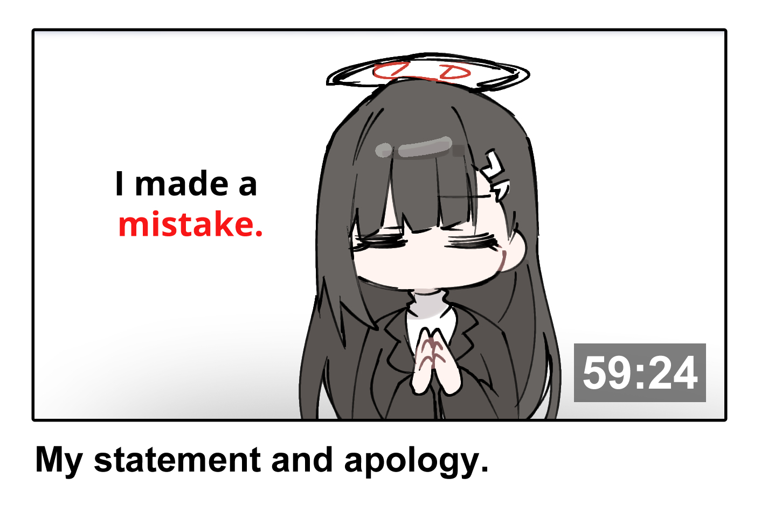


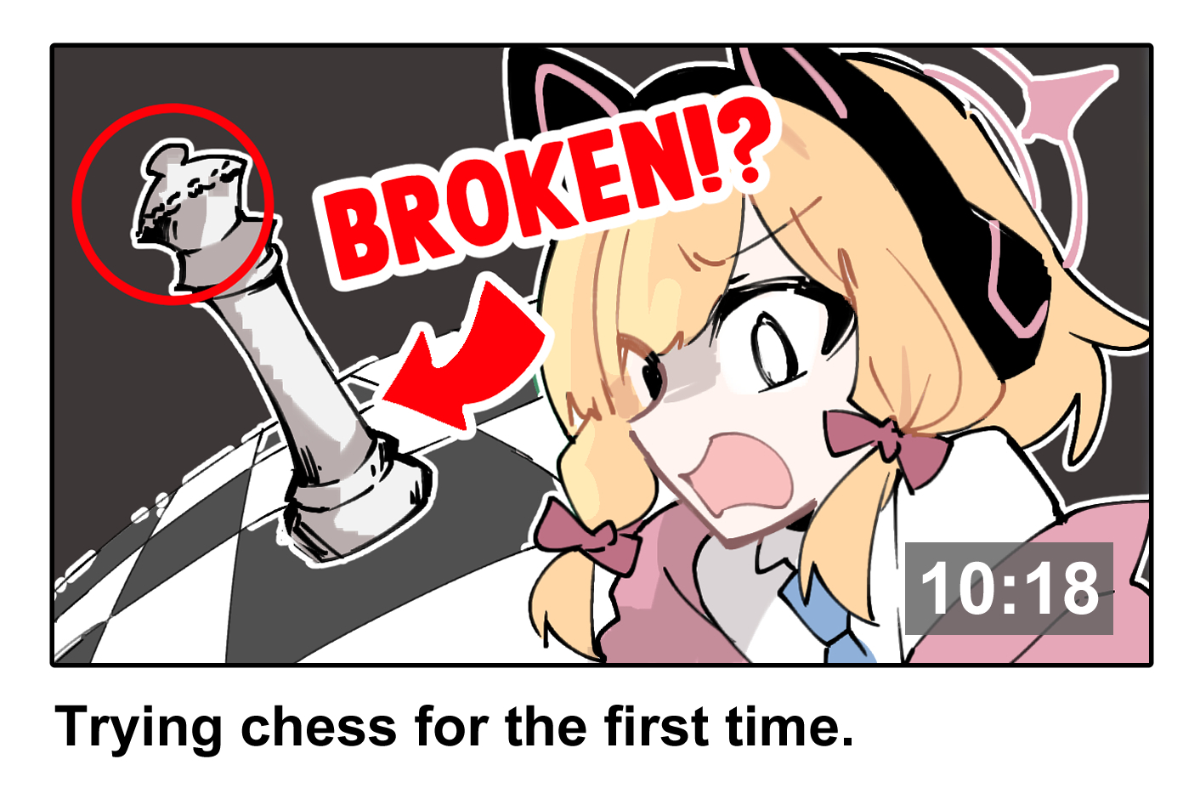
HOME BALIK
EPISODES YUGTO
MORE HIGIT
MEDIA MIDYA
COMMUNITY FORUM

